Slide 1

Capstone project 2
NYC TAXI TRIP TIME PREDICTION
Individual project
DSN NAVEEN KUMAR

Slide 2
CONTENT
Introduction
Problem statement
Data summary
Exploratory Data Analysis (EDA)
Feature Engineering & Selection
Building and Evaluating Model
Conclusion

Slide 3
INTRODUCTION
In New York City, due to traffic jams, construction or road blockage etc. user will need to know how much time it will take to commute from one place to other.
Increasing popularity of app-based taxi such as ola or uber and there competitive pricing levels made user decisive to choose based on trip pricing and duration.
Taxi Drivers also have to choose best route having lesser trip time.
So here we will be building a model which will be predicting the trip duration of taxies running in NewYork. This prediction will help customers to select the taxi based on trip duration and driver to select optimum route to their destination.

Slide 4
PROBLEM STATEMENT
We have the dataset which is based on the 2016 NYC Yellow Cab trip record. The data was originally published by the NYC Taxi and Limousine Commission (TLC). Based on individual trip attributes, our task is to build a model that predicts the total ride duration of taxi trips in New York City.

Slide 5
DATA SUMMARY
id - a unique identifier for each trip
vendor_id - a code indicating the provider associated with the trip record
pickup_datetime - date and time when the meter was engaged
dropoff_datetime - date and time when the meter was disengaged
passenger_count - the number of passengers in the vehicle (driver entered value)
pickup_longitude - the longitude where the meter was engaged
pickup_latitude - the latitude where the meter was engaged
dropoff_longitude - the longitude where the meter was disengaged
dropoff_latitude - the latitude where the meter was disengaged
store_and_fwd_flag - This flag indicates whether the trip record was held in vehicle memory before sending to the vendor because the vehicle did not have a connection to the server - Y=store and forward; N=not a store and forward trip
trip_duration - duration of the trip in seconds

Slide 6
BASIC EXPLORATION
The dataset contains 1458644 rows and 11 columns.
Two categorical features ‘store_and_fwd_flag’ and ‘vendor_id’
Outliers present in all numerical features
Data formating steps required for datetime features
No null values present

Slide 7
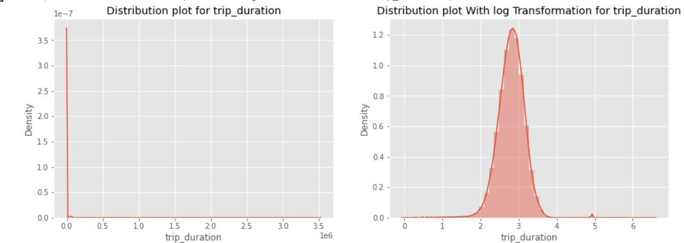
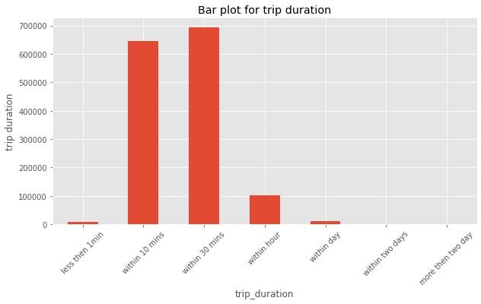
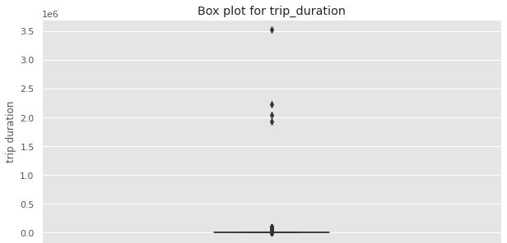
TRIP DURATION DATA ANALYSIS

Slide 8
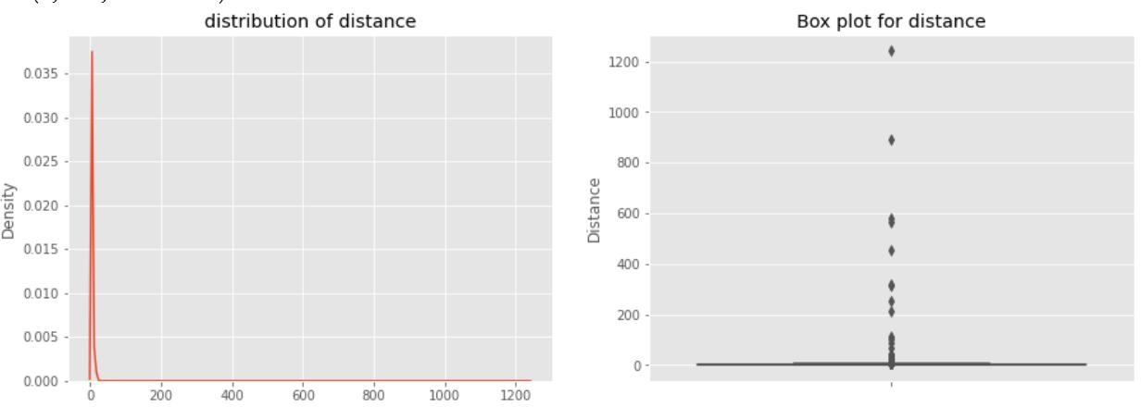
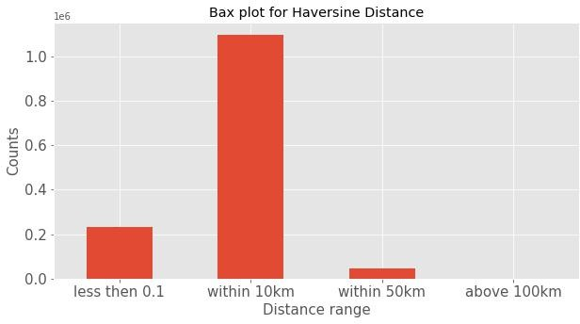
Haversine Distance
𝜑 −𝜑 𝜆 −𝜆
2
2 2
2
2 2
𝐷 = 2𝑟𝑠𝑖𝑛⁻¹ ( 𝑠𝑖𝑛 (
) + 𝑐𝑜𝑠(𝜑 )𝑐𝑜𝑠(𝜑 )𝑠𝑖𝑛 (
))
2
1
2
2

Slide 9
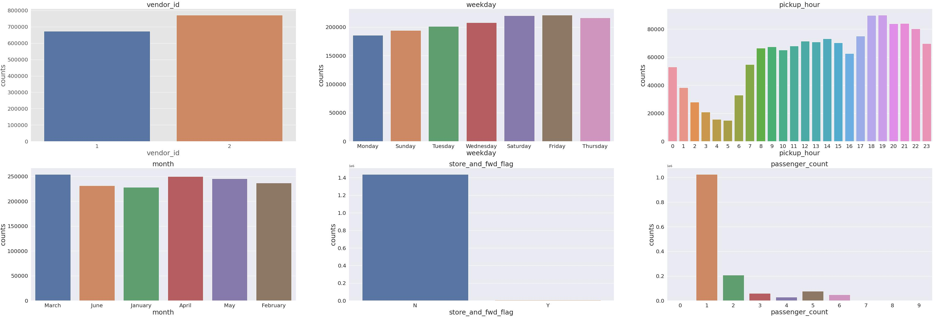
Categorical Variable Analysis

Slide 10
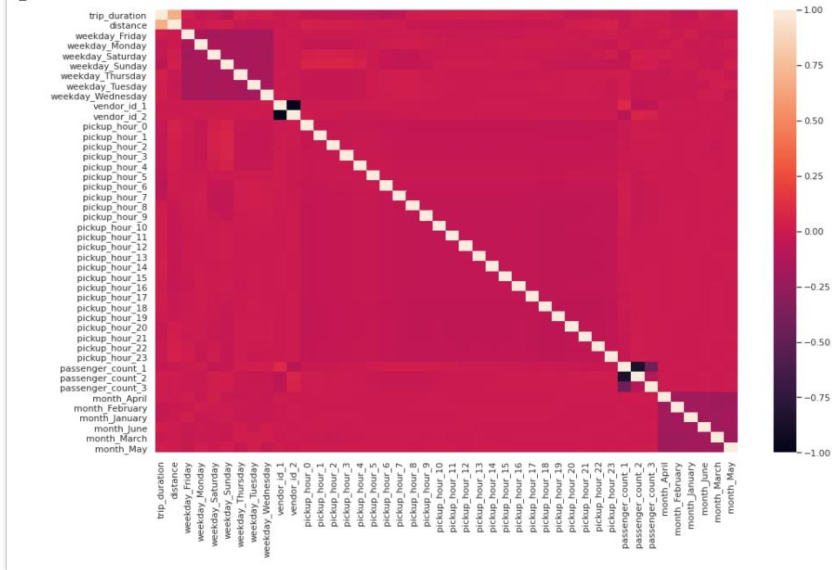
Correlation Analysis

Slide 11
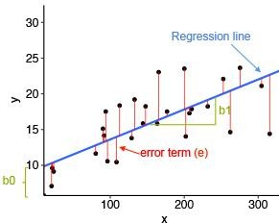
Linear Regression
Linear Regression is a regression of dependent variable on independent variable. It is a linear model that assumes a linear relationship between dependent
(y) and independent variables (x). The dependent variable (y) is calculated by l inear combination of independent variable (x).
y=b₀+b₁ x₁ +b₂x₂
The cost function for linear regression is given by:
Mean of sum of square error
_{𝑆 =} ^{∑ (}𝑐𝑢𝑙 ⁻ 𝑟𝑑𝑖𝑐𝑑⁾²
MSE | 130903.06
RMSE | 361.81
R2 | 0.6089
Adjusted_R2 | 0.6083
N

Slide 12
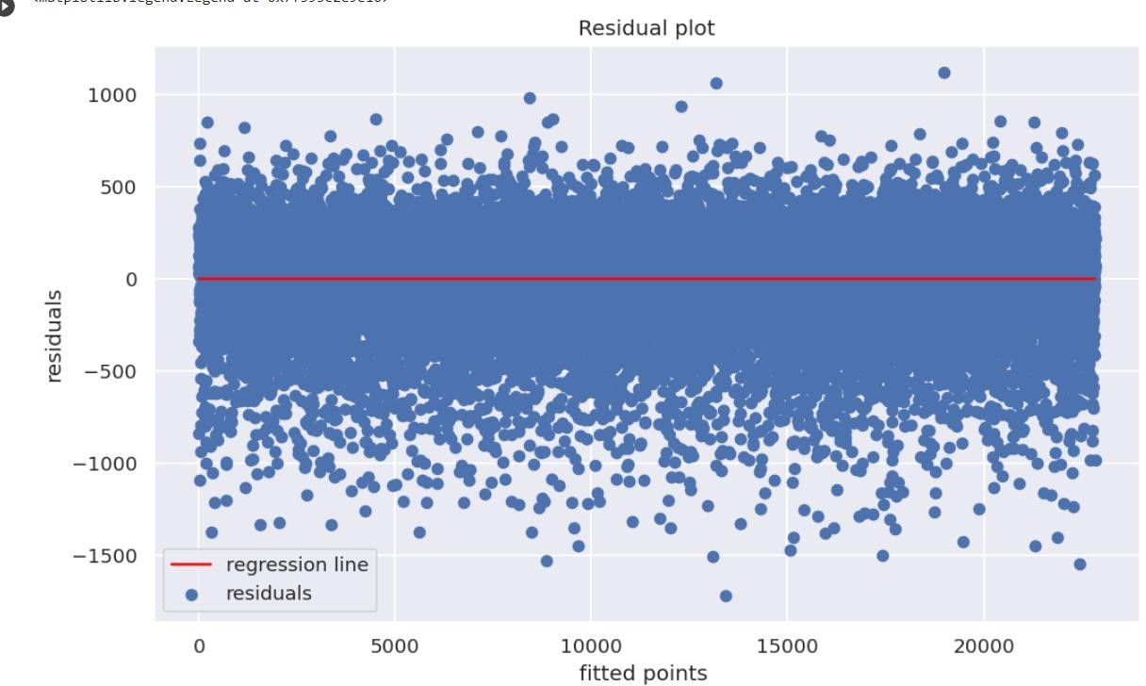
Homoscedasticity check

Slide 13
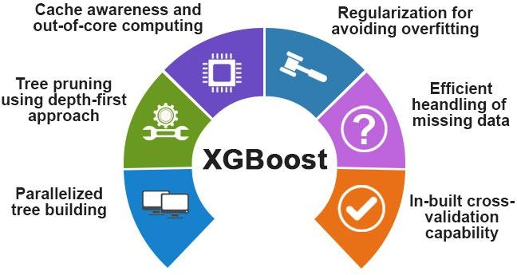
XGBoost
XGBoost comes under boosting and is known as extra gradient boosting.
GBM first calculates the model using X and Y then after the prediction is obtain.
It will again calculates the model based on residual of previous model
loss function will give more weightage to error of previous model. and this process continuous until MSE gets minimizes.
XGBoost is just an extension of GBM with following advantages.
Regularization
Parallel Processing
High Flexibility
Handles Missing values
Tree pruning
Buitin cross validation
Continuous on existing model
MSE | 105226.37
RMSE | 324.39
R2 | 0.6856
Adjusted_R2 | 0.6083

Slide 14

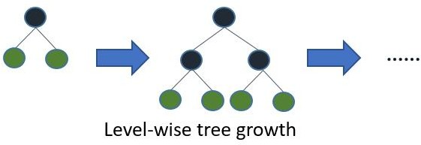
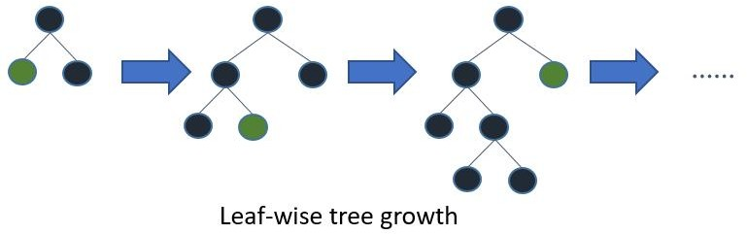
LightGBM
LightGBM is a fast, distributed high performance gradient boosting framework.
LightGBM is based on decision tree algorithm. But it splits the tree leaf wise rather then level wise like other boosting algorithm. So when growing on the same leaf in Light GBM, the leaf- wise algorithm can reduce more loss than the level-wise algorithm and hence results in much better accuracy which can rarely be achieved by any of the existing boosting algorithms.
MSE | 95652.24
RMSE | 309.28
R2 | 0.7142
Adjusted_R2 | 0.7138

Slide 15
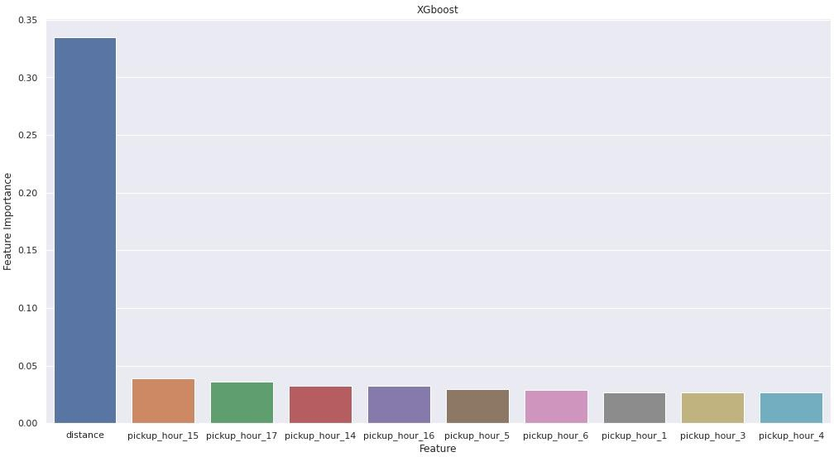
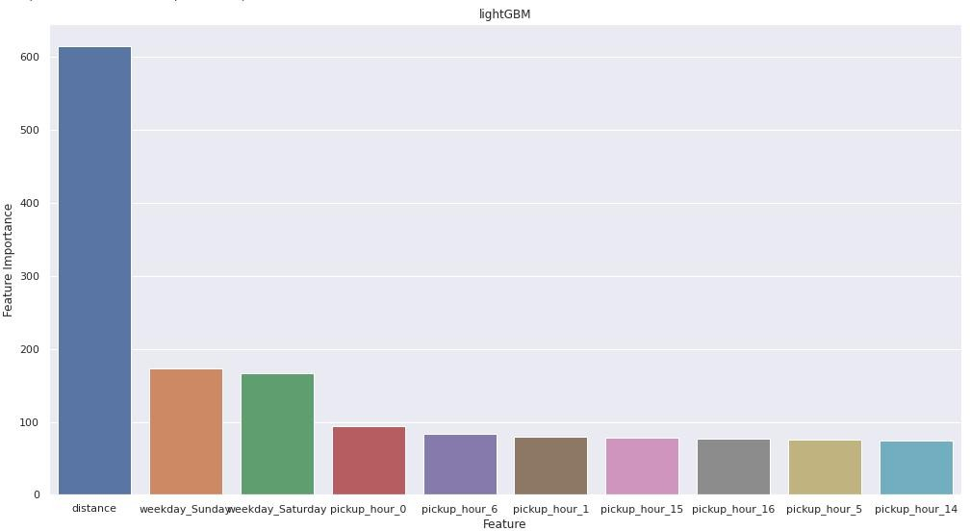
Feature Importance

Slide 16
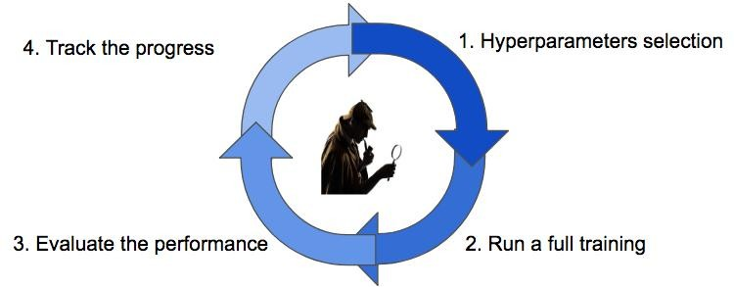
Hyperparameter Tuning
Hyperparameters are sets of information that are used to control the way of learning an algorithm.
We used Grid Search CV, for hyperparameter tuning. This also results in cross-validation and in our case we divided the dataset into different folds
Hyperparameters | XGBoost | LightGBM
n_estimator | [5,10,20] | [5,10,20]
max_depth | [5,7,9] | [5,7,9]
min_samples_split | [40,50] | [40,50]
cv | 3 | 3
eval_Score | R2 | R2
Metric | XGBoost | LightGBM
MSE | 103672.2 | 103515.51
RMSE | 321.98 | 321.74
R2 | 0.6933 | 0.6938
Adjusted_R2 | 0.6857 | 0.6862

Slide 17
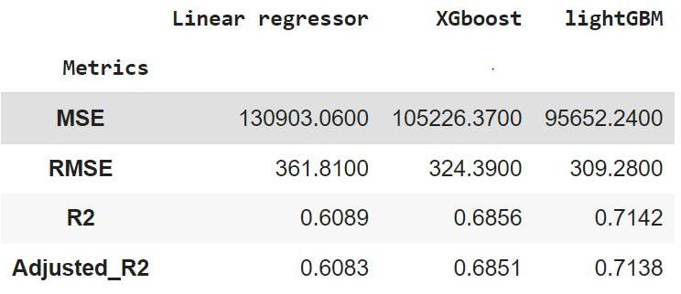
Final Metrics Conclusion

Slide 18
Conclusion
•
In this project, I tried to predict the trip duration of a taxi in NYC.
I am mostly concerned with the information of pick up latitude and longitude and drop off latitude and longitude, to get the distance of the trip.
Hyperparameter tuning doesn’t improve much accuracy.
Linear regression gives 60.89 % accuracy,XGBoost gives 68.56% accuracy, LightGBM gives 71.42% on the test set.
LightGBM is more fitter and efficient than XGBoost for taxi trip duration-based predictions
LightGBM will be the best model to predict the trip duration for a particular taxi.

Slide 19
Challenges
Handling Large Dataset
Feature Engineering
Computation Time
Optimising The Model

Slide 20



